Slide 1
Ch-6
Servlet

Slide 2
Introduction
Web development is all about communication. In this case, communication between 2 parties, over the HTTP protocol:
The Server - This party is responsible for serving pages.
The Client - This party requests pages from the Server, and displays them to the user. On most cases, the client is a web browser.
The User - The user uses the Client in order to surf the web, fill in forms, watch videos online, etc

Slide 3
Basic Example
The User opens his web browser (the Client).
The User browses to http://google.com.
The Client (on the behalf of the User), sends a request to http://google.com (the Server), for their home page.
The Server then acknowledges the request, and replies the client with some meta-data (called headers), followed by the page's source.
The Client submits that data to the Server.
The Server processes that data, and replies with a page matching the search results.
The Client, once again, renders that page for the User to view.

Slide 4
Server-side Programming
Server-side programming, is the general name for the kinds of programs which are run on the Server. Server side programming is about generating dynamic content.
Back-end
Uses
Process user input.
Display pages.
Structure web applications.
Interact with permanent storage (SQL, files).
Example Languages
PHP
ASP.Net in C#, C++, or Visual Basic.

Slide 5
Client-side Programming
Client-side programming is the name for all of the programs which are run on the Client.
Front-end
Uses
Make interactive web pages.
Interact with temporary storage, and local storage (Cookies, local Storage).
Send requests to the server, and retrieve data from it.
Provide a remote service for client-side applications, such as software registration, content delivery, or remote multi-player gaming.
Example languages
JavaScript (primarily)
HTML*
CSS*

Slide 6
A servlet is a Java programming language class that dynamically loaded on web server, is used to extend the capabilities of servers that host applications accessed by means of a request- response programming model.
Sevlets are objects that generate dynamic content after processing request that originate from web browser.
They are java components that are used to generate dynamic web applications.
They can run on any java platform and are ususally designed to process HTTP requests, Ex: GET ,POST

Slide 7
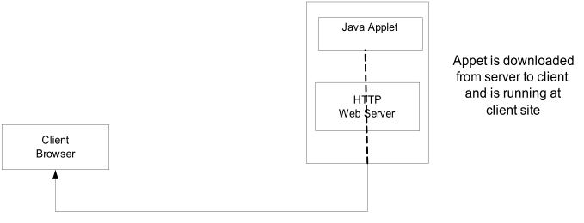
Applet Vs. Servlet

Slide 8
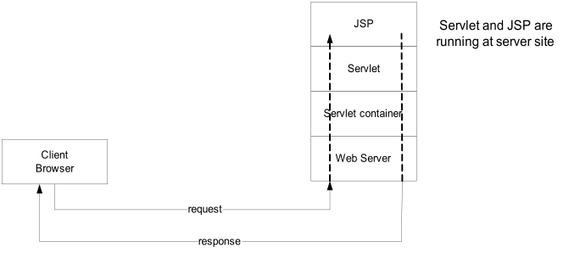

Slide 9
Applet | Servlet
Applets are programs on client side. | Servlets are programs on server side.
Applets can make request to servlets. | Servlets are intended to respond the applets or HTML program.
Applets run over the browser | servlets run over the server.
Applets may have GUI. | Servlets have no GUI.
Applets are useful to develop the static web pages | Servlets are useful to develop the dynamic web pages.

Slide 10
CGI Vs. Servlet
CGI (Common Gateway Interface) is the very first attempt at providing users with dynamic content. It allows users to execute a program that resides in the server to process data and even access databases in order to produce the relevant content. Since these are programs, they are written in the native operating system and then stored in a specific directory.
A servlet is an implementation of Java that aims to provide the same service as CGI does, but instead of programs compiled in the native operating system, it compiles into the Java byte code which is then run in the Java virtual machine. Though Java programs can be compiled into the native code, they still prefer to compile in the Java bytecode

Slide 11
Advantages of servlet over CGI
CGI programs are platform dependent while servlets are platform independent.
Each request is answered in CGI in separate process by separate instance , in servlet no need to generate separate process for each request.
A CGI program needs to be loaded and started on each CGI request, servlets stay in memory while serving requests.
Servlets saves memory as it creates single instance for all the requests as wells as gives efficient performance.

Slide 12
CGI are usually executables that are native to the server’s operating system, though servlets can also be compiled to the native OS it can be compiled to Java byte code which is then run on a JVM Servlets can run by servlet engines, so more secure that CGI.
Full functionalities of java class libraries is available to servlets. Servlets can communicate with applets, HTML, programs , databases and RMI programs.

Slide 13
Uses of Servlet
Processing and/or storing data submitted by an HTML form.
Providing dynamic content, e.g. returning the results of a database query to the client.
A Servlet can handle multiple request concurrently and be used to develop high performance system
Managing state information on top of the stateless HTTP, e.g. for an online shopping cart system which manages shopping carts for many concurrent customers and maps every request to the right customer.

Slide 14
Benefits of Servlet
Performance
The performance of servlets is superior to CGI because there is no process creation for each client request.
Each request is handled by the servlets container process.
After a servlet has completed processing a request, it stays resident in memory, waiting for another request.
Portability
Like other Java technologies, servlets applications are portable.
Rapid development cycle
As a Java technology, servlets have access to the rich Java library that will help speed up the development process.
Robustness
Servlets are managed by the Java Virtual Machine.
Don't need to worry about memory leak or garbage collection, which helps you write robust applications.
Widespread acceptance
Java is a widely accepted technology.

Slide 15
Features of Servlet
Efficient
Persistent
Portable
Robust
Extensible
Secured
Standard based

Slide 16
Servlet Container Architecture
HTTP Request
Servlet
Container
Servlet
Browser
HTTP
Server
HTTP Response
Static
Content

Slide 17
How Servlets Work
is servlet
loaded?
Receive
Request
No
Yes
is servlet
current?
No
Load Servlet
Yes
Send
Response
Process Request

Slide 18
Servlet
A Servlet component can delegate the requests to its back-end tier such as a database management system, RMI, EAI, or other Enterprise Information System (EIS).
A Servlet is deployed as a middle tier just like other web components such as JSP components.
The Servlet components are building block components, which always work together with other components such as JSP components, JavaBean components, Enterprise Java Bean (EJB) components, and web service components.
A Servlet component is also a distributed component, which can provide services to remote clients and also access remote resources.

Slide 19
Support Environments for Java Servlet
A Java Servlet application is supported by its Servlet container.
The Apache Tomcat web server is the official reference implementation of Servlet containers, supporting Servlets and JSP.

Slide 20
A Servlet has a lifecycle just like a Java applet. The lifecycle is managed by the Servlet container.
There are three methods in the Servlet interface, which each Servlet class must implement. They are init(), service(), and destroy().

Slide 21
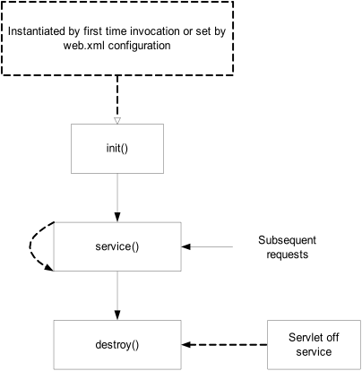

Slide 22
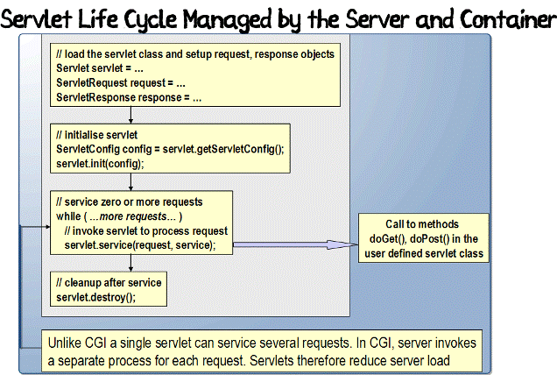

Slide 23
A servlet can be loaded when:
First request is made.
Server starts up (auto-load).
There is only a single instance which answers all requests concurrently. This saves memory and allows a Servlet to easily manage persistent data.
Administrator manually loads.
A servlet is unloaded when:
Server shuts down.
Administrator manually unloads

Slide 24
Servlet Architecture
A Java Servlet is a typical Java class that extends the abstract class HttpServlet.
The HttpServlet class extends another abstract class called GenericServlet.
The GenericServlet class implements three interfaces: javax.servlet.Servlet,
javax.servlet.ServletConfig, and java.io.Serializable.

Slide 25
GenericServlet | HttpServlet
The GenericServlet is an abstract class that is extended by HttpServlet to provide HTTP protocol-specific methods. | An abstract class that simplifies writing HTTP servlets. It extends the GenericServlet base class and provides an framework for handling the HTTP protocol.
The GenericServlet does not include protocol-specific methods for handling request parameters, cookies, sessions and setting response headers. | The HttpServlet subclass passes generic service method requests to the relevant doGet() or doPost() method.
GenericServlet is not specific to any protocol. | HttpServlet only supports HTTP and HTTPS protocol

Slide 26
HttpServlet - Methods
void doGet (HttpServletRequest request, HttpServletResponse response)
handles GET requests
void doPost (HttpServletRequest request,
HttpServletResponse response)
handles POST requests
void doPut (HttpServletRequest request,
HttpServletResponse response)
handles PUT requests
void doDelete (HttpServletRequest request,
HttpServletResponse response)
handles DELETE requests

Slide 27
GenericServlet - Methods
void init(ServletConfig config)
Initializes the servlet.
void service(ServletRequest req, ServletResponse res)
Carries out a single request from the client.
void destroy()
Cleans up whatever resources are being held (e.g., memory, file handles, threads) and makes sure that any persistent state is synchronized with the servlet's current in-memory state.
ServletConfig getServletConfig()
Returns a servlet config object, which contains any initialization parameters and startup configuration for this servlet.
String getServletInfo()
Returns a string containing information about the servlet, such as its author, version, and copyright.

Slide 28
doGet() | doPost()
In doGet() the parameters are appended to the URL and sent along with header information. | In doPost(), on the other hand will (typically) send the information through a socket back to the webserver and it won't show up in the URL bar.
The amount of information you can send back using a GET is restricted as URLs can only be 1024 characters. | You can send much more information to the server this way - and it's not restricted to textual data either. It is possible to send files and even binary data such as serialized Java objects!
doGet() is a request for information; it does not (or should not) change anything on the server | doPost() provides information (
Parameters are not encrypted | Parameters are encrypted
It allows bookmarks. | It disallows bookmarks.
doGet() is faster if we set the response content length since the same connection is used. Thus increasing the performance | doPost is slower compared to doGet since doPost does not write the content length

Slide 29
Servlet Request object
provides client request information to a servlet.
the servlet container creates a servlet request object and passes it as an argument to the servlet's service method.
the ServletRequest interface define methods to retrieve data sent as client request:
parameter name and values
attributes
input stream
HTTPServletRequest extends the ServletRequest interface to provide request information for HTTP servlets

Slide 30
HttpServletRequest - Methods
getParameterNames()
an Enumeration of String objects, each String containing the name of a request parameter; or an empty Enumeration if the request has no parameters
getParameterValues (java.lang.String name)
Returns an array of String objects containing all of the values the given request parameter has, or null if the parameter does not exist.
getParameter (java.lang.String name)
Returns the value of a request parameter as a String, or null if the parameter does not exist.

Slide 31
getCookies()
Returns an array containing all of the Cookie objects the client sent with this request.
getMethod()
Returns the name of the HTTP method with which\thi request was made, for example, GET, POST, or PUT.
getQueryString()
Returns the query string that is contained in the request URL after the path.
getSession()
Returns the current session associated with this request, or if the request does not have a session, creates one.

Slide 32
Steps to execute servlet
Create a directory structure under Tomcat/Glassfish for your application.
Write the servlet source code.
Compile your source code.
deploy the servlet
Run Tomcat
Call your servlet from a web browser

Slide 33
Servlet Response Object
Defines an object to assist a servlet in sending a response to the client.
The servlet container creates a ServletResponse object and passes it as an argument to the servlet's service method

Slide 34
HttpServletResponse - Methods
getWriter()
Returns a PrintWriter object that can send
character text to the client
setContentType (java.lang.String type)
Sets the content type of the response being sent to the client. The content type may include the type of character encoding used, for example, text/html; charset=ISO-8859-4
getBufferSize()
Returns the actual buffer size used for the response

Slide 35
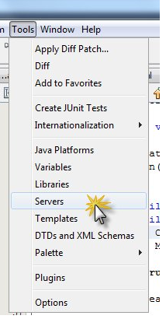
Install Apache
Install Netbeans
Select Install Apache checkbox.
“After Installation in c drive you will find folder for apache”
Goto Tools-> Server

Slide 36
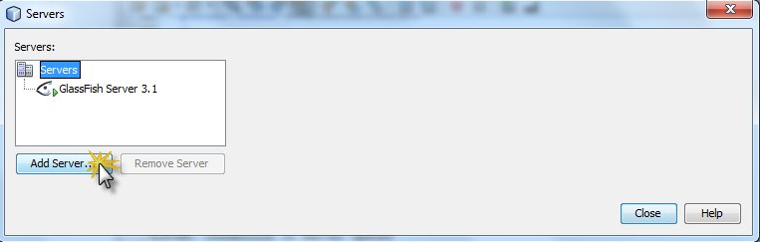
Install Apache
Click On ADD Server

Slide 37
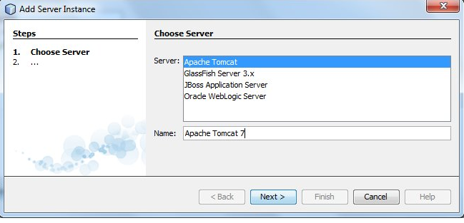
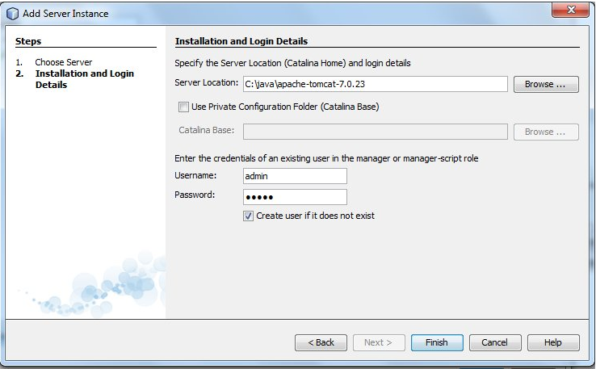
Install Apache

Slide 38
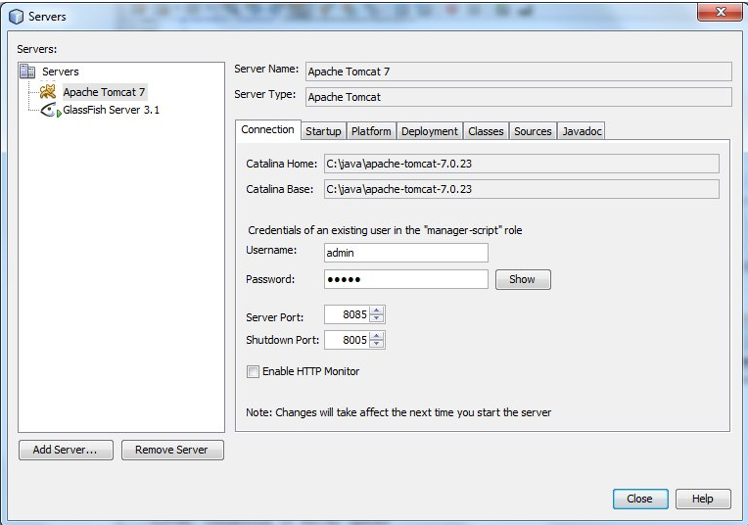

Slide 39
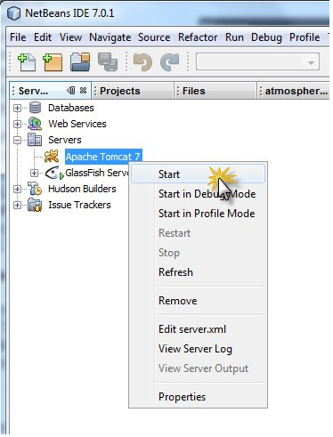
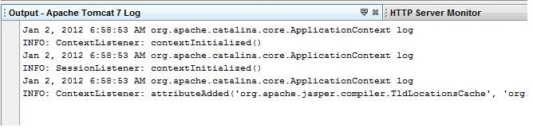
Start Tomcat Server

Slide 40
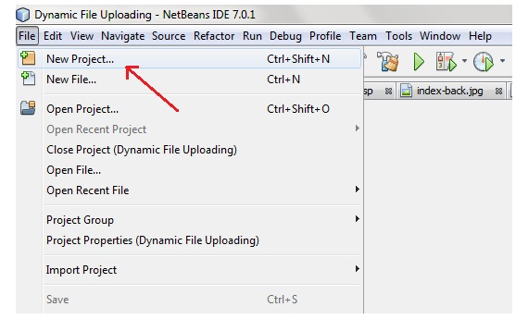

Slide 41
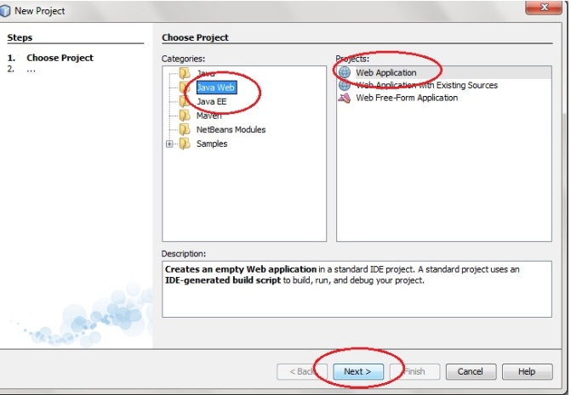

Slide 42
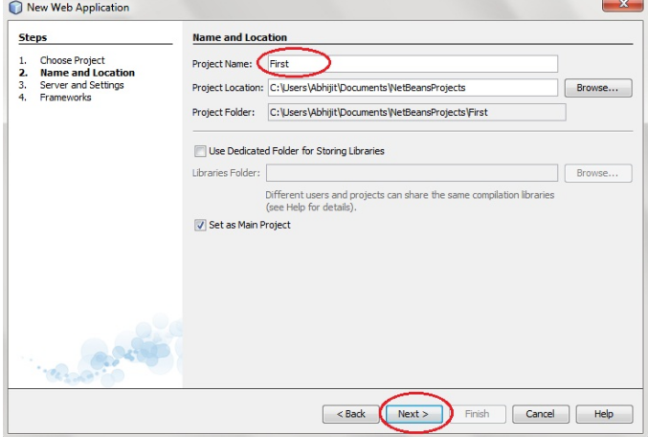

Slide 43
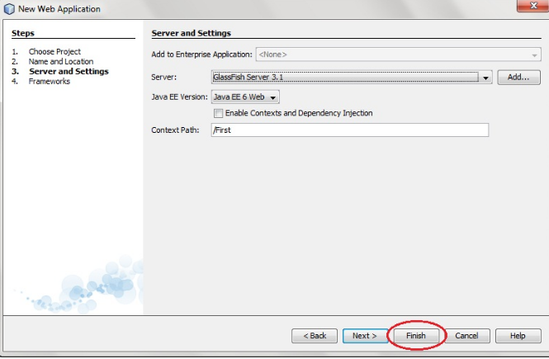

Slide 44
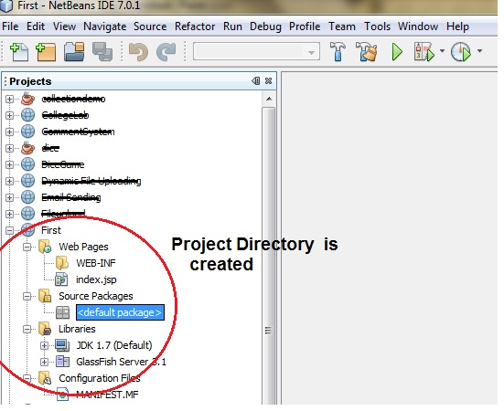

Slide 45
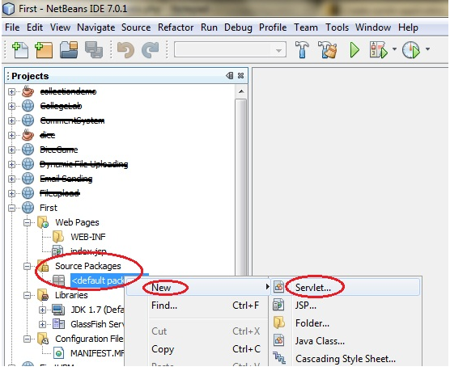

Slide 46
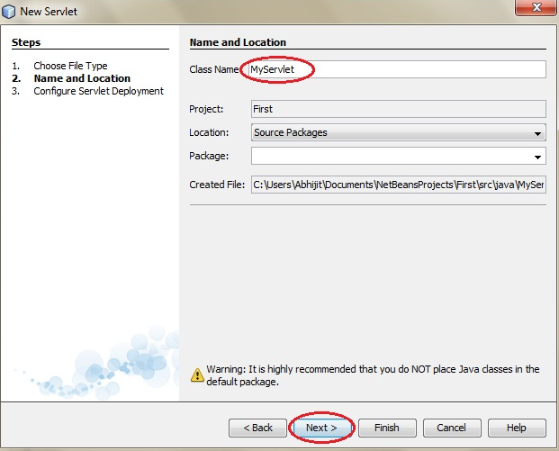

Slide 47
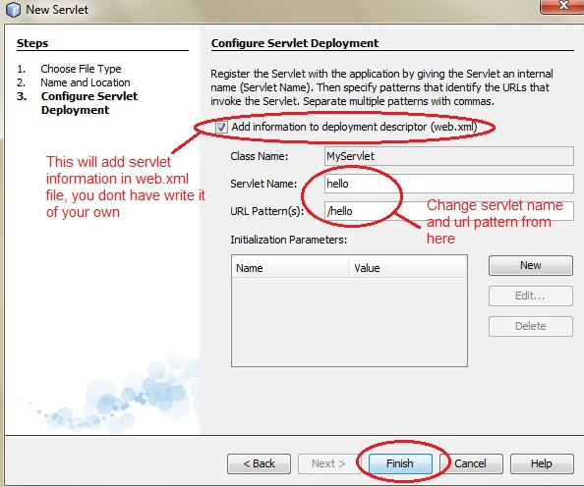

Slide 48
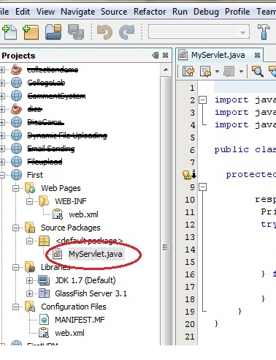

Slide 49
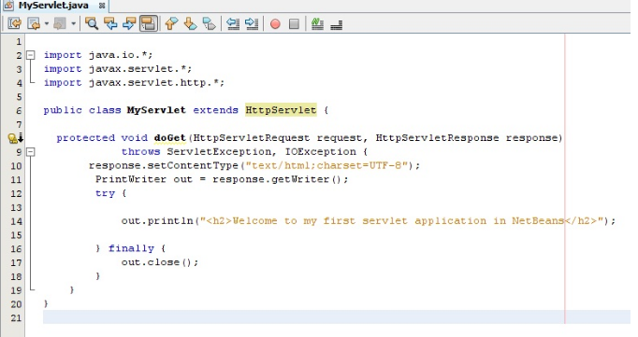

Slide 50
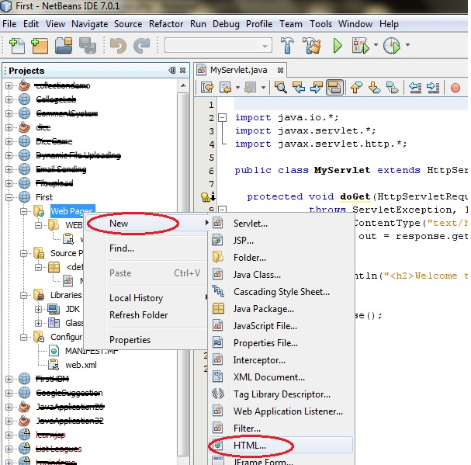

Slide 51
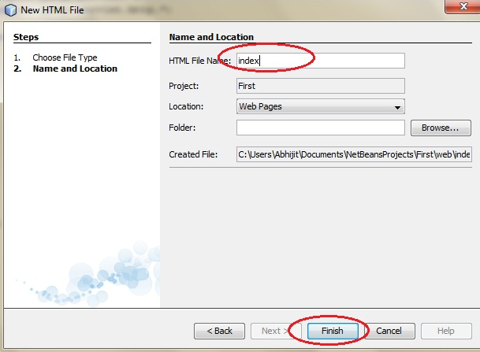

Slide 52
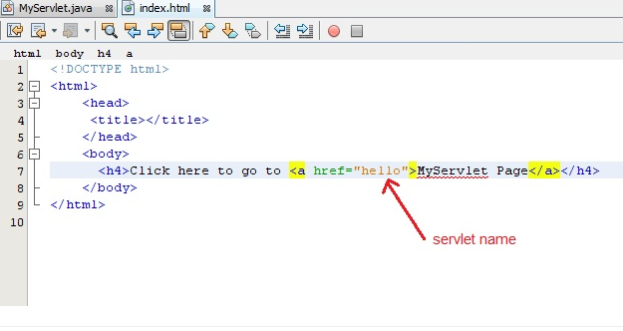

Slide 53
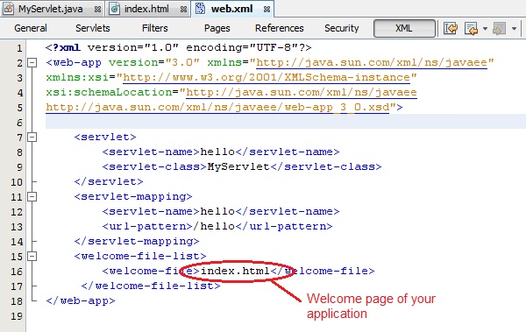

Slide 54
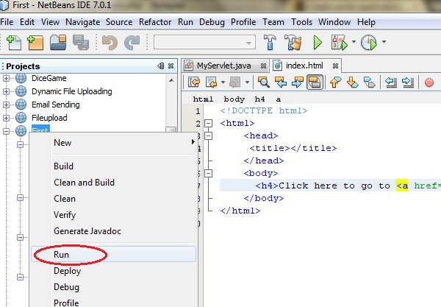

Slide 55
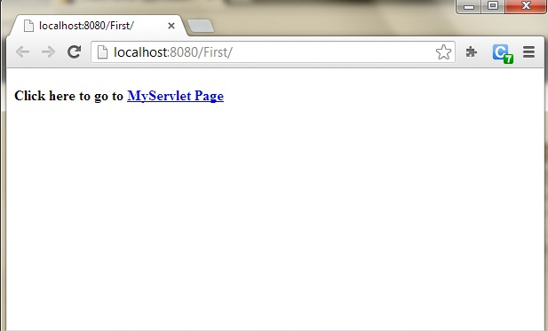
output

Slide 56
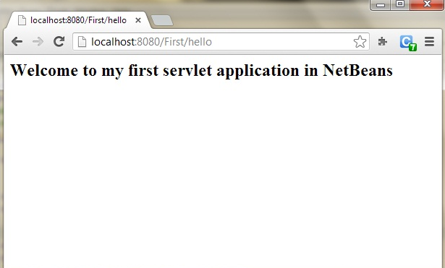

Slide 57
Running service() on a single thread
By default, servlets written by specializing the HttpServlet class can have multiple threads concurrently running its service() method.
If you would like to have only a single thread running a service method at a time, then your servlet should also implement the SingleThreadModel interface.
This does not involve writing any extra methods, merely declaring that the servlet implements the interface.

Slide 58
Example
public class SurveyServlet extends HttpServlet implements SingleThreadModel
{
/* typical servlet code, with no threading concerns
* in the service method. No extra code for the
* SingleThreadModel interface. */
...
}

Slide 59
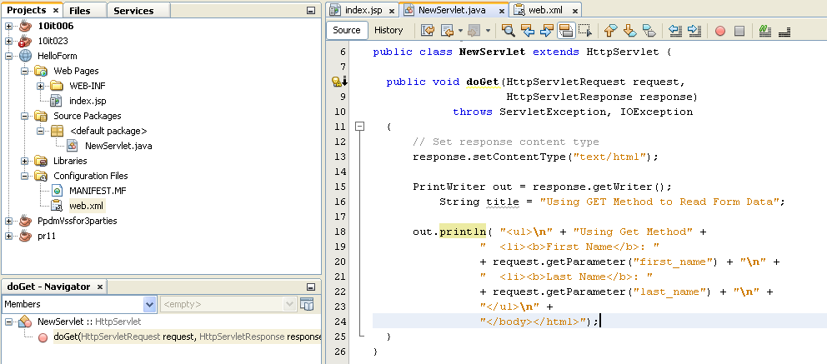
Program Using get method

Slide 60
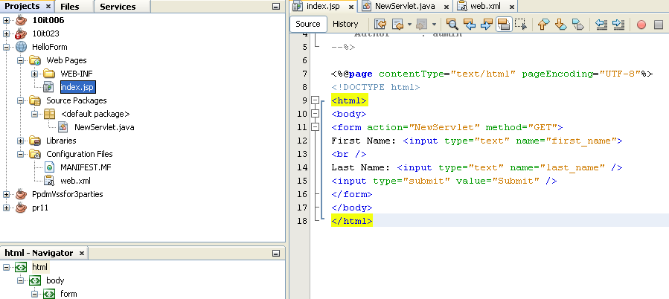

Slide 61
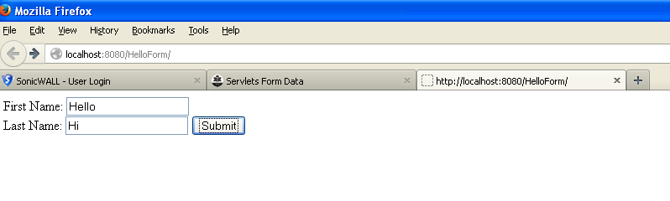

Slide 62
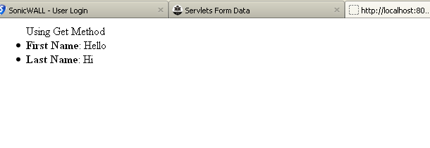

Slide 63
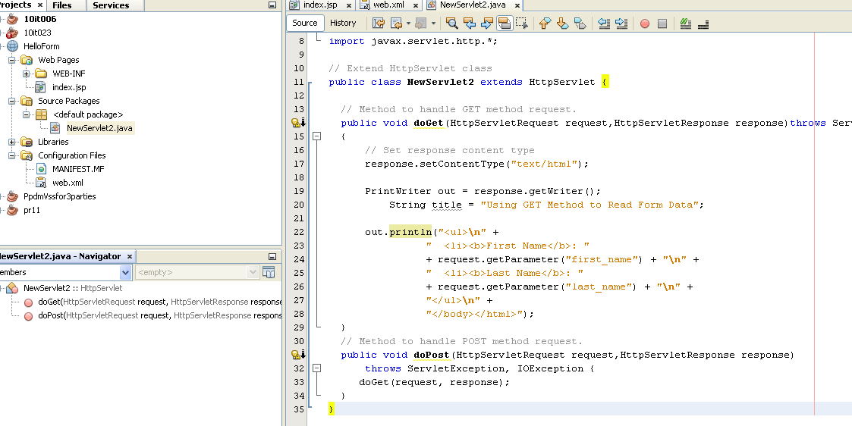
Program using post method

Slide 64
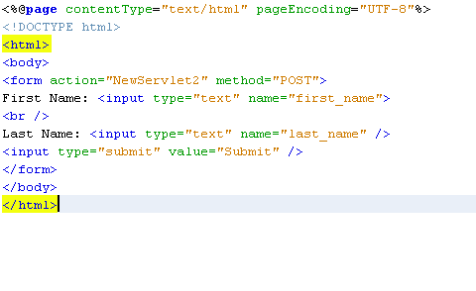

Slide 65
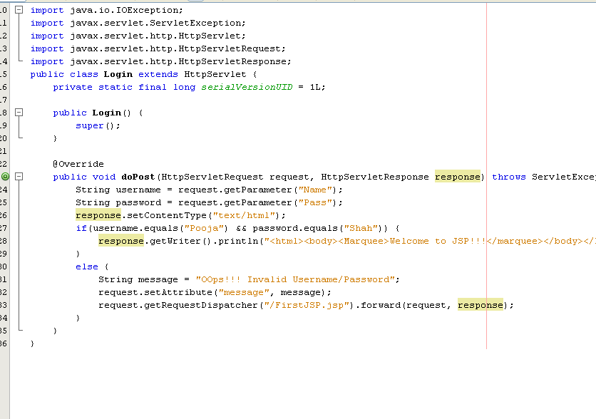
Login Example

Slide 66
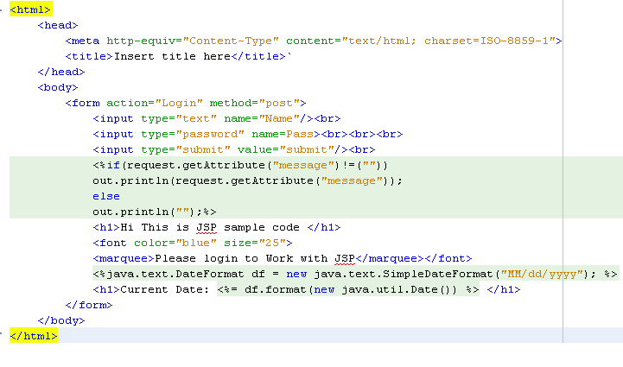

Slide 67
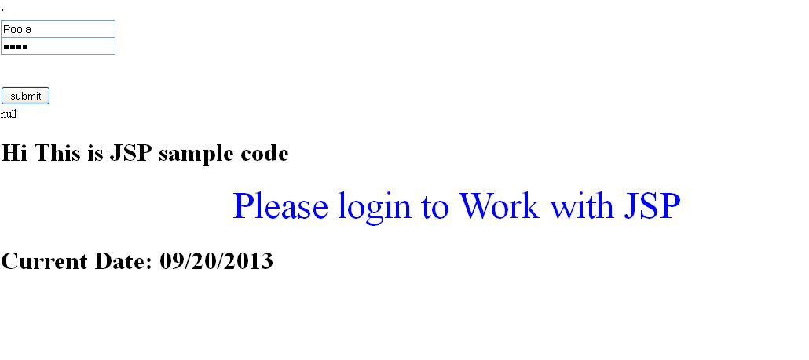

Slide 68
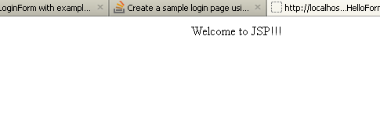
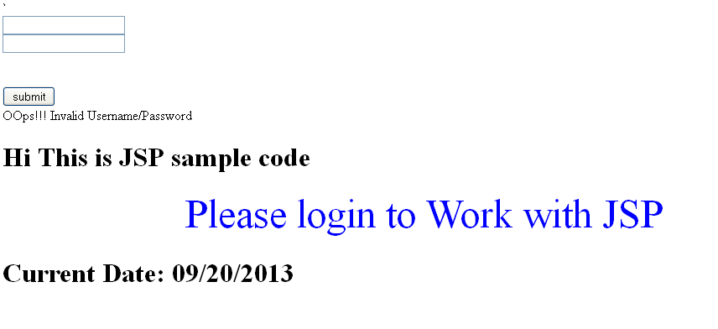

Slide 69
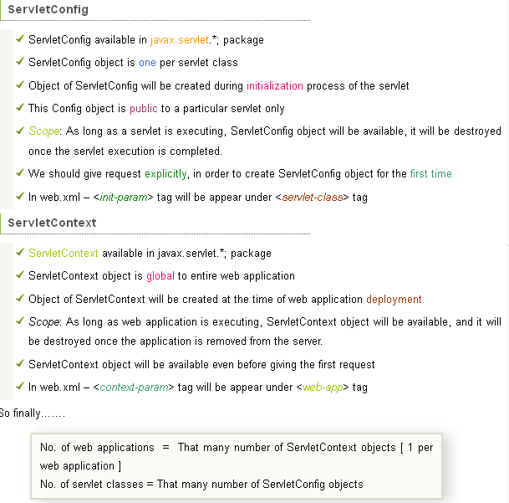
Servletconfig Vs. ServletContext

Slide 70
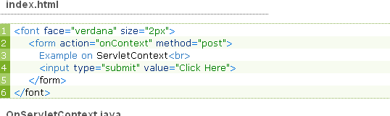
Example program of ServletContext

Slide 71
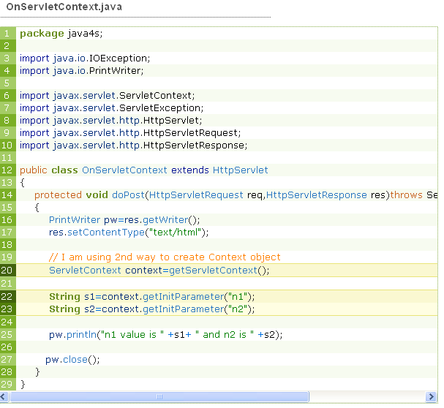

Slide 72
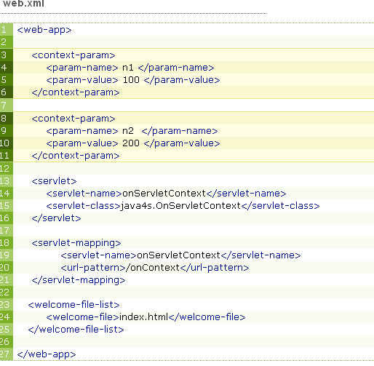

Slide 73
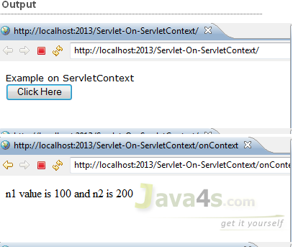

Slide 74
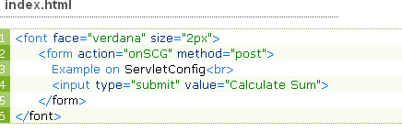
Program for ServletConfig

Slide 75
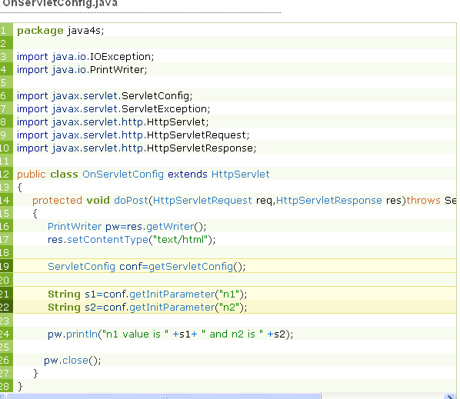

Slide 76
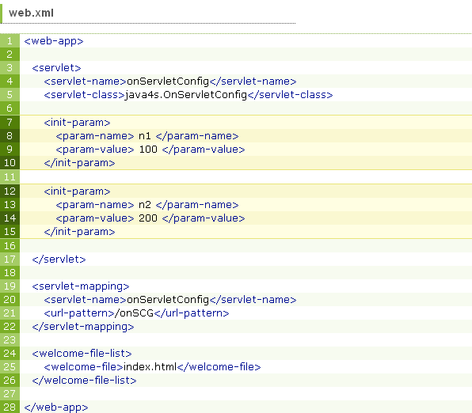

Slide 77
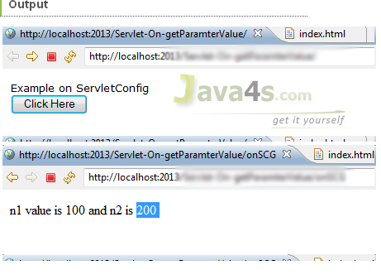

Slide 78
Servlet with Database connectivity
import java.io.IOException;
import java.io.PrintWriter;
import java.sql.Connection;
import java.sql.DriverManager;
import java.sql.ResultSet;
import java.sql.SQLException;
import java.sql.Statement;
import javax.servlet.ServletException;
import javax.servlet.http.HttpServlet;
import javax.servlet.http.HttpServletRequest;
import javax.servlet.http.HttpServletResponse;
public class ConnectDB extends HttpServlet {

Slide 79
public void doGet(HttpServletRequest req, HttpServletResponse res)
throws IOException, ServletException {
res.setContentType("text/html");
PrintWriter pw = res.getWriter();
Connection con = null;
Statement stmt = null;
ResultSet rs = null;
try {
Class.forName("sun.jdbc.odbc.JdbcOdbcDriver");
con = DriverManager.getConnection("jdbc:odbc:Hello");
stmt = con.createStatement();
rs = stmt.executeQuery("SELECT* FROM servlet");
pw.println("ID \t \t Name \t \t Place<br>");

Slide 80
while (rs.next()) {
pw.println("\t \t \t \t \t");
pw.println(rs.getObject(1).toString());
pw.println(rs.getObject(2).toString());
pw.println(rs.getObject(3).toString());
pw.println("<br>");
}
} catch (SQLException e) {
pw.println(e.getNextException());
} catch (ClassNotFoundException e) {
pw.println(e.getException());
}

Slide 81
finally {
try {
if (rs != null) {
rs.close();
rs = null;
}
if (stmt != null) {
stmt.close();
stmt = null;
}
if (con != null) {
con.close();
con = null;
}
} catch (Exception e) {
pw.close();
}}}}

Slide 82
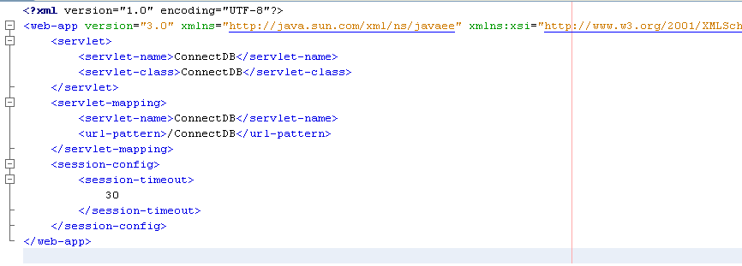

Slide 83
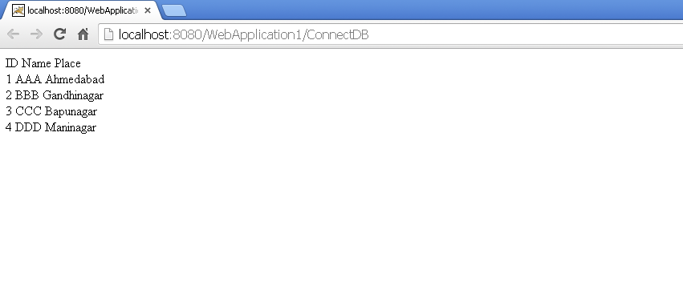

Slide 84

sendRedirect method

Slide 85



Slide 86


Slide 87
Session
A session is a collection of HTTP requests shared between client & server over period of time.
While creating session, you require to set lifetime,by default 30 minutes.
After the set lifetime expires, the session is destroyed & all its resources are returned back to servlet engine.
Session tracking is a process of gathering user information from web pages, which can be used in application. Ex: shopping cart application.

Slide 88
Session tracking involves identifying user sessions by related ID.
Cookies & URL rewriting are example of session tracking.
Implemented through HTTP session objects by servlet container in application server.
The scope of HTTP session object is limited to single client.

